Slide 1
COMP 2920 : Software Architecture & Design

Slide 2
Lesson Objectives
Discuss and understand activity diagrams
Understand the elements of activity diagrams
Activity
Transition
Synch. Bar
Decision Diamond
Start & Stop Markers

Slide 3
Activity Diagram
Describes how activities are coordinated.
Is particularly useful when you know that an operation has to achieve a number of different things, and you want to model what the essential dependencies between them are, before you decide in what order to do them.
Records the dependencies between activities, such as which things can happen in parallel and what must be finished before something else can start.
Represents the workflow of the process.

Slide 4
Notation
2. Transition
Activity1()
Activity2()
1. Activities

Slide 5
Notation - 2
[x>0]
[x>=0]
Activity1()
[x=0]
[x<0]
[x<0]
3. Decision Diamond

Slide 6
Notation - 3
4.1 Synch. Bar (Join)
4.2 Splitting Bar (Fork)
{AND}
{OR}
{XOR}

Slide 7
Notation - 3
Start Marker
Stop Marker
5. Start & Stop Markers

Slide 8
Notation - 4
Developers
Testers
Markers
Swimlane
Swimlane
Swimlane
Application/Department/Group/Role Boundaries

Slide 9
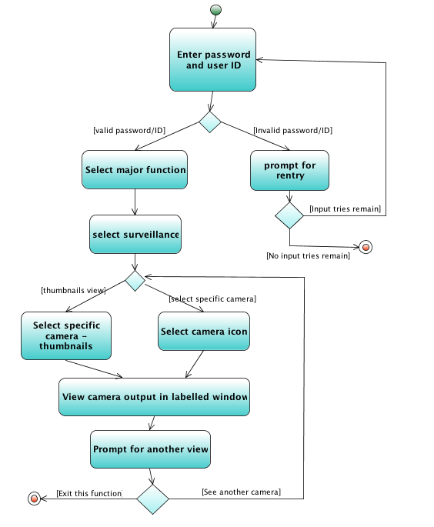
Activity Diagram
Supplements the use-case by providing a diagrammatic representation of procedural flow
Details:
Start is a single circle
End is a bulls-eye
Decisions are diamonds (guards must be on both branches of the diamond!)
Questions:
Do we always have a start?
Do we always have an end?
How might we make this better?

Slide 10
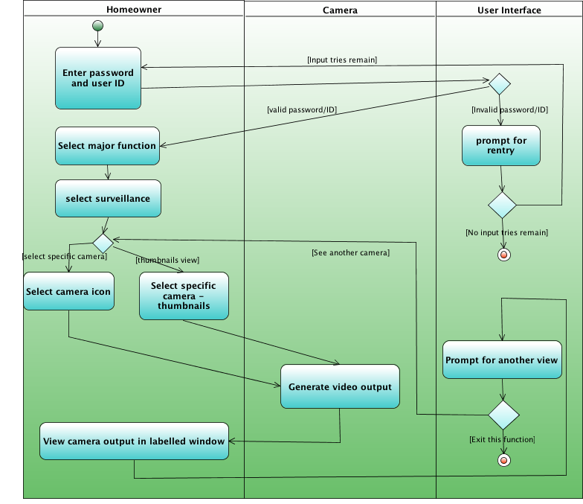
Swimlane Diagrams
Allows the modeler to represent the flow of activities described by the use-case and at the same time indicate which actor (if there are multiple actors involved in a specific use-case) or analysis class has responsibility for the action described by an activity rectangle
Notes:
Diagram from Netbeans UML (UMLProject1)

Slide 11
Example: Business Level Activity Diagram
of the Library
member
Librarian
[borrower]
Find book on shelf
[returning]
[returner]
Wait in queue
[borrowing]
Record return
Put book back of shelf
Record borrowing
Prepare for next
member

Slide 12
Activity Diagrams (1)
To model the dynamic aspects of a system
It is essentially a flowchart
Showing flow of control from activity to activity
Purpose
Model business workflows
Model operations

Slide 13
Activity Diagrams (2)
Activity diagrams commonly contain
Activity states and action states
Transitions
Objects

Slide 14
Action States and Activity States
Action states are atomic and cannot be decomposed
Work of the action state is not interrupted
Activity states can be further decomposed
Their activity being represented by other activity diagrams
They may be interrupted

Slide 15
Transitions (1)
When the action or activity of a state completes, flow of control passes immediately to the next action or activity state
A flow of control has to start and end someplace
initial state -- a solid ball
stop state -- a solid ball inside a circle

Slide 16
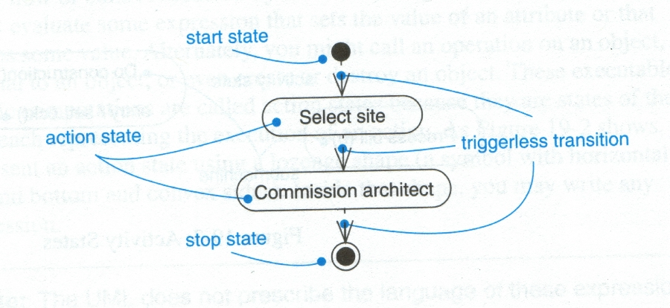
Transitions (2)

Slide 17
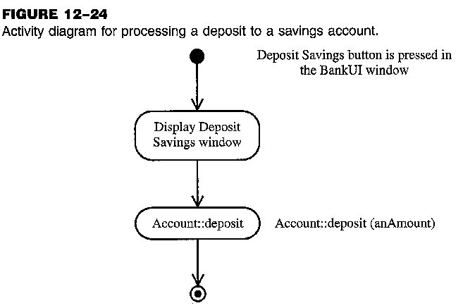
Activity Diagram: Example

Slide 18
Branching (1)
A branch specifies alternate paths taken based on some Boolean expression
A branch may have one incoming transition and two or more outgoing ones

Slide 19
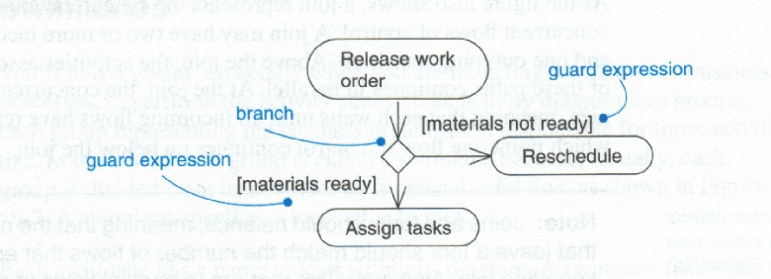
Branching (2)

Slide 20
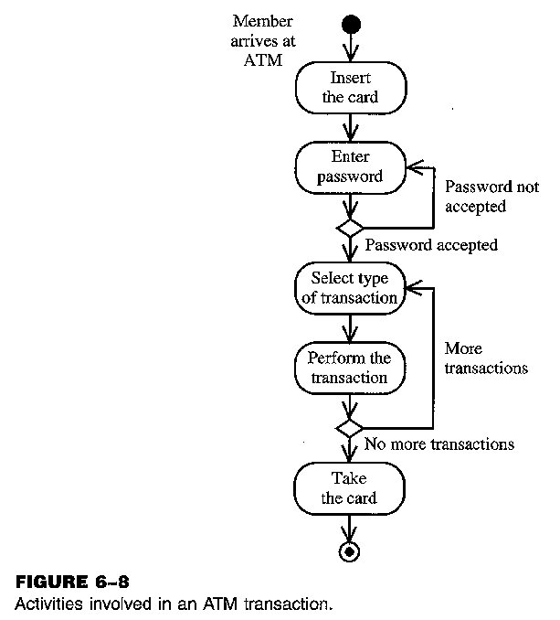
Activity Diagram: Example (2)

Slide 21
Forking and Joining
Use a synchronization bar to specify the forking and joining of parallel flows of control
A synchronization bar is rendered as a thick horizontal or vertical line

Slide 22
Fork
A fork may have one incoming transitions and two or more outgoing transitions
each transition represents an independent flow of control
conceptually, the activities of each of outgoing transitions are concurrent
either truly concurrent (multiple nodes)
or sequential yet interleaved (one node)

Slide 23
Join
A join may have two or more incoming transitions and one outgoing transition
above the join, the activities associated with each of these paths continues in parallel
at the join, the concurrent flows synchronize
each waits until all incoming flows have reached the join, at which point one flow of control continues on below the join

Slide 24
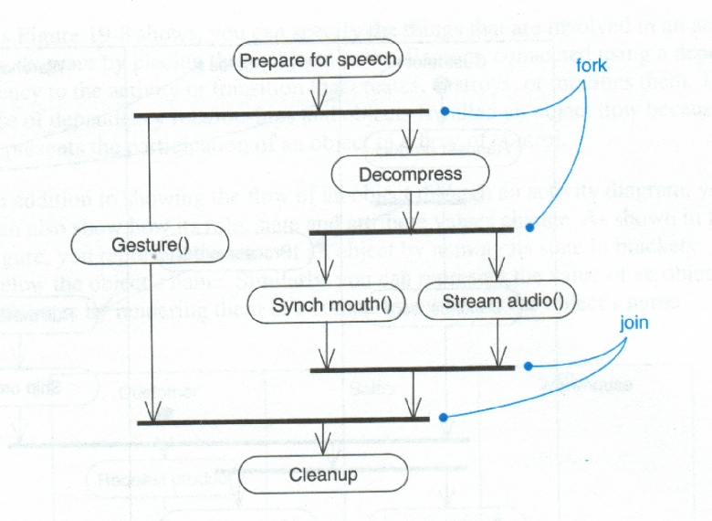
Fork

Slide 25
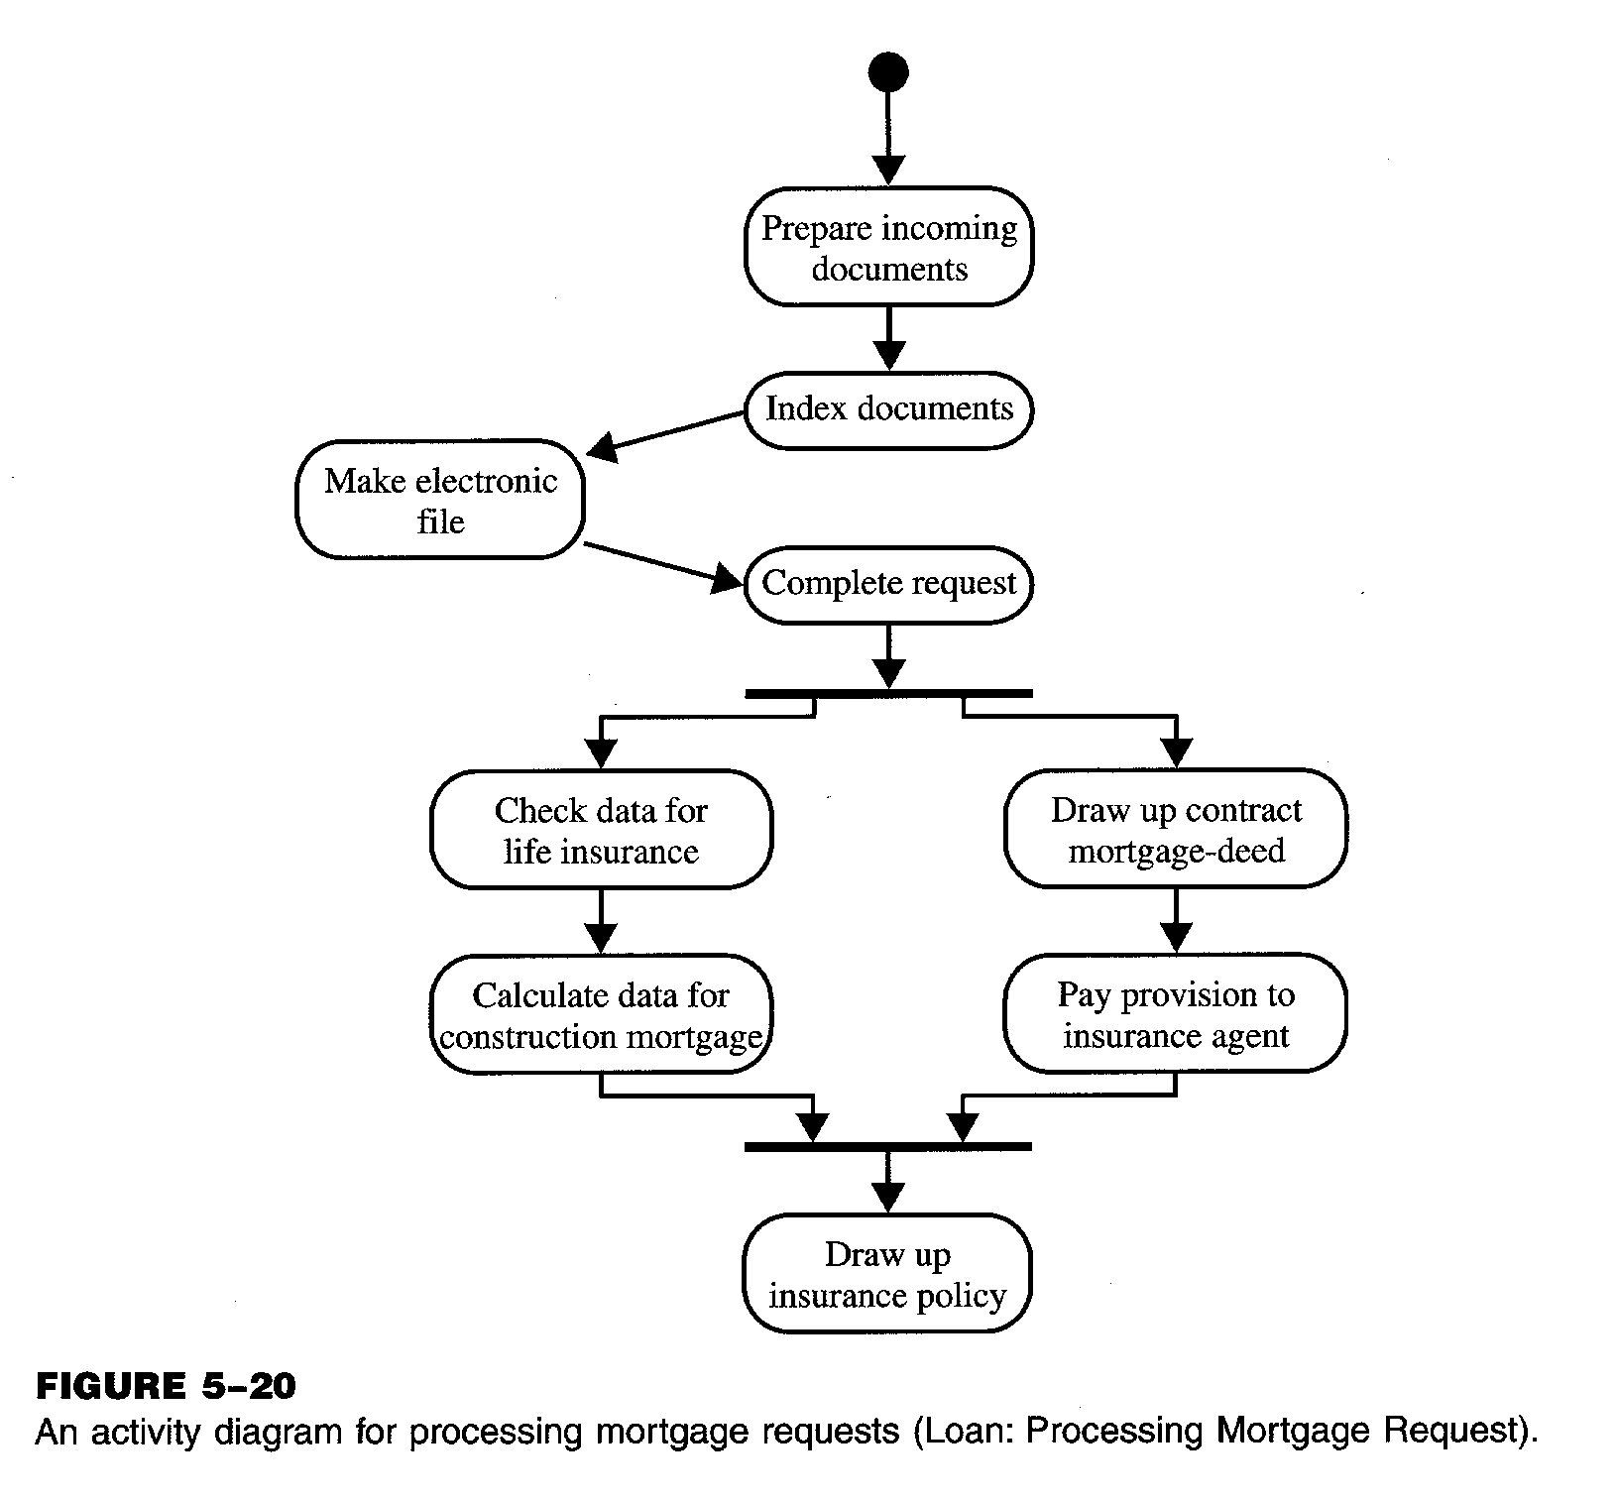
Activity Diagram: Example (3)

Slide 26
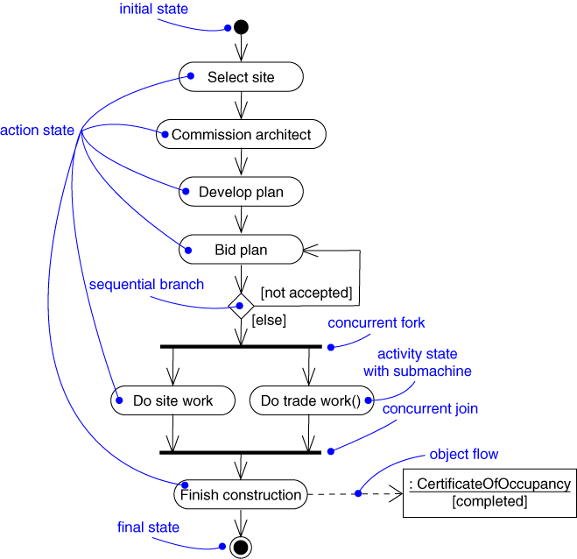
Activity Diagram: Example (4)

Slide 27
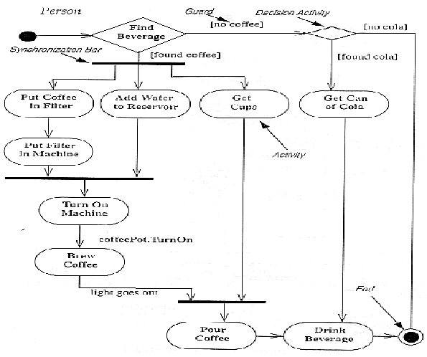
Activity Diagram: Example (5)

Slide 28
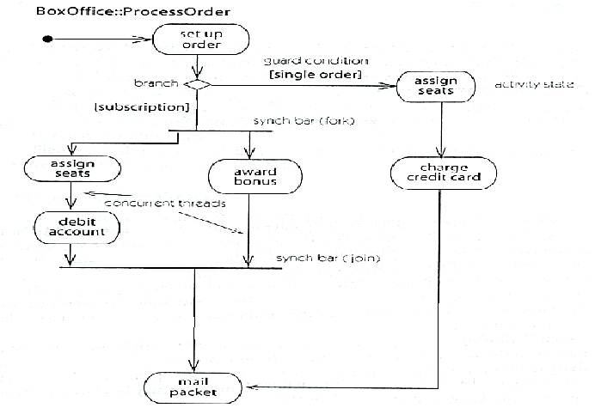
Activity Diagram: Example (6)

Slide 29
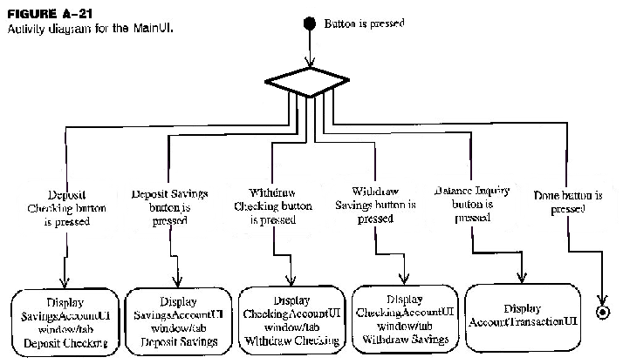
Activity Diagram: Example (7)

Slide 30
Swimlanes (1)
A swimlane specifies a locus of activities
To partition the activity states on an activity diagram into groups
each group representing the business organization responsible for those activities
each group is called a swimlane
Each swimlane is divided from its neighbor by a vertical solid line

Slide 31
Swimlanes (2)
Each swimlane has a name unique within its diagram
Each swimlane may represent some real-world entity
Each swimlane may be implemented by one or more classes
Every activity belongs to exactly one swimlane, but transitions may cross lanes

Slide 32
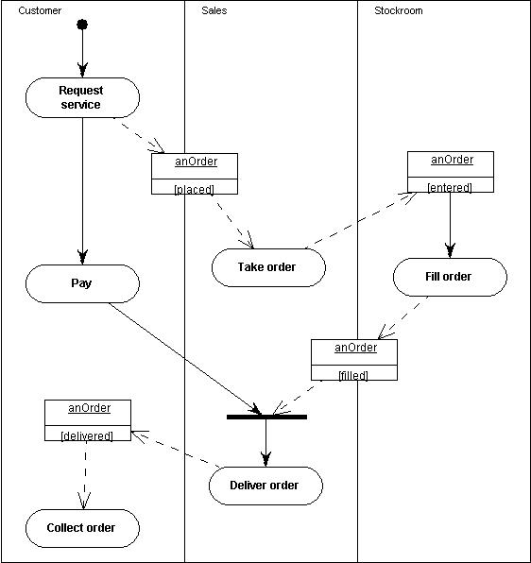
Activity Diagram: Example (8)

Slide 33
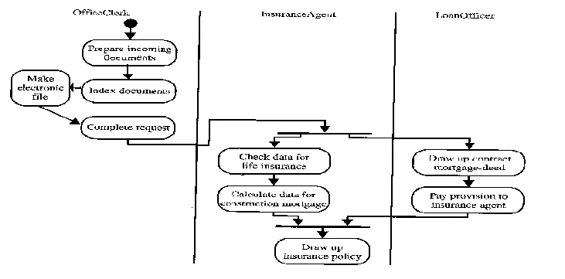
Activity Diagram: Example (9)

Slide 34
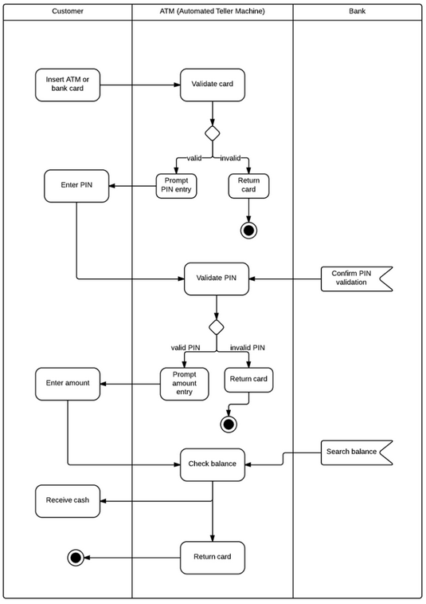
ATM machine example

Slide 35
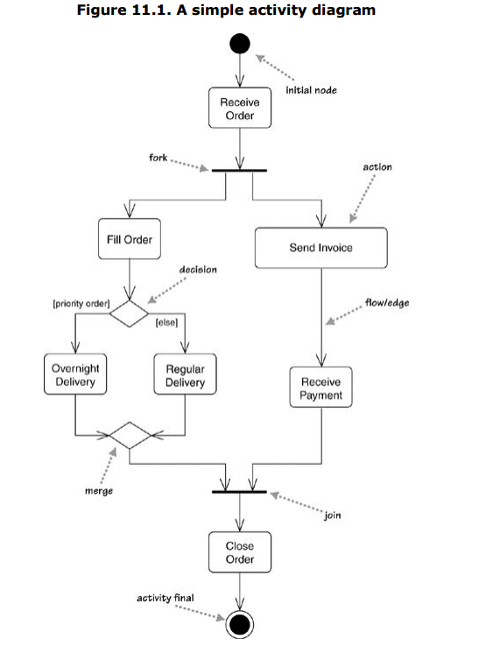
Example

Slide 36
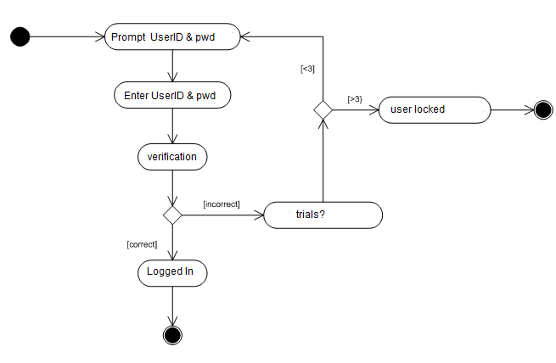
Example

Slide 37
Discussion Questions
What are the element of activity diagrams?
T/F
Activity diagram is a behavior model.
Activity diagram is a control model.
Define:
Activity diagram

